Slide 1


How do temperature niches evolve when temperatures change? A review.
Sarthak Malusare and Emanuel A. Fronhofer

Slide 2
Introduction
Temperature directly affects the metabolic rates of a given organism.
In turn the metabolic rate of the organism affects its life history traits, its population dynamics and also its higher trophic interactions (Brown et al., 2004; Uszko et al., 2017).
Strategies to persist in a given environment may thus change as the temperature changes over time.
How temperature niches of various organisms changes, in response to the rapid climate change therefore becomes very intriguing to study.

Slide 3
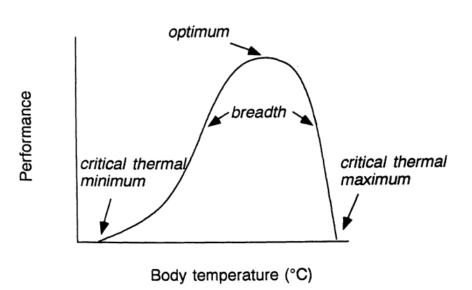
Introduction: Thermal Niche

Slide 4
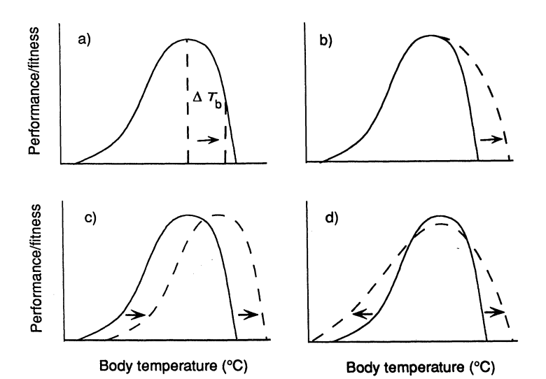
Introduction: Thermal niche evolution

Slide 5
Methods and procedure
An extensive and systematic literature review using the ISI Web of Science database which provided me 2630 research papers.
Algorithm used :
ts = (temperature)
and
ts = (experimental evolution or artificial selection or selection experiment or laboratory selection)
and
ts=(microcosm* or mesocosm* or chemostat* or experiment*) not ts=(cancer* OR cardio* OR surg* OR carcin* OR medic* OR crop or drug*)
and
wc = (Behavioral Sciences or Ecology or Evolutionary Biology or Limnology or Marine & Freshwater Biology or Microbiology or Multidisciplinary Sciences or Plant Sciences or Zoology or Biochemical Research Methods)
and
py=1900-2019
39 papers containing temperature selection experiments and assays in which fitness is measured at more than two temperature points.
27 relevant which contain temperature selection experiments and assays in which fitness is measured at only two temperature points.
We further selected papers in which relative fitness of the temperature selected populations was utilized or could be calculated from the paper.

Slide 6
Methods and procedure
Selected papers
mean and confidence interval of the fitness proxy
Calculating relative fitness
niches shift and how their widths change over the selection experiment
establish the generality and parallels

Slide 7
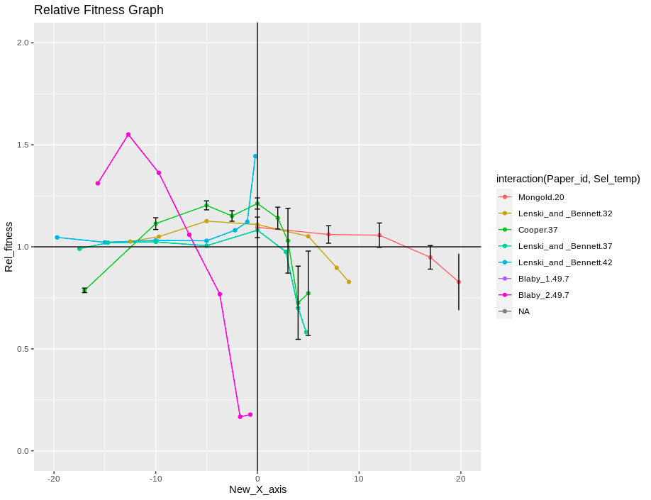
Results

Slide 8
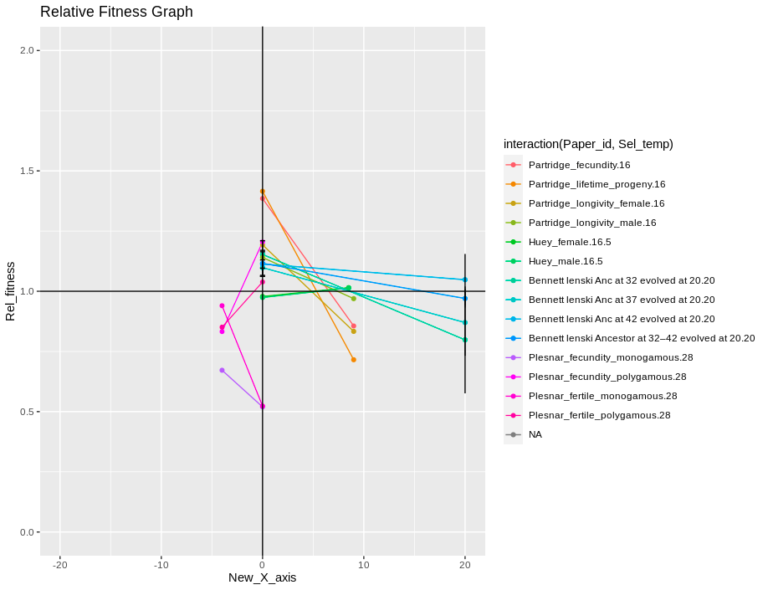
Results

Slide 9
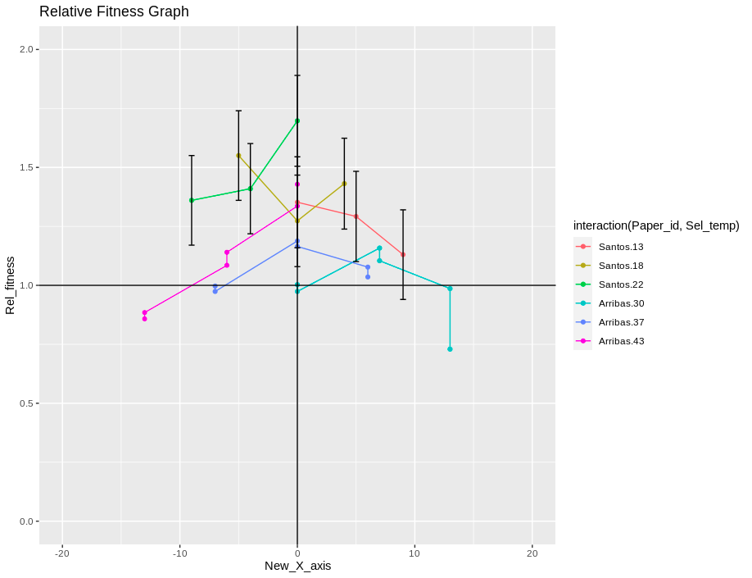
Results

Slide 10
Conclusions
In general, populations selected at a particular temperature show relative fitness greater than 1, at the selection temperature
Populations face higher fitness trade-offs at higher assay temperature
Populations face lower fitness trade-offs at lower assay temperatures

Slide 11

Thank-you

